Slide 1
Hockey Regression Project
Austin Schwoegl

Slide 2
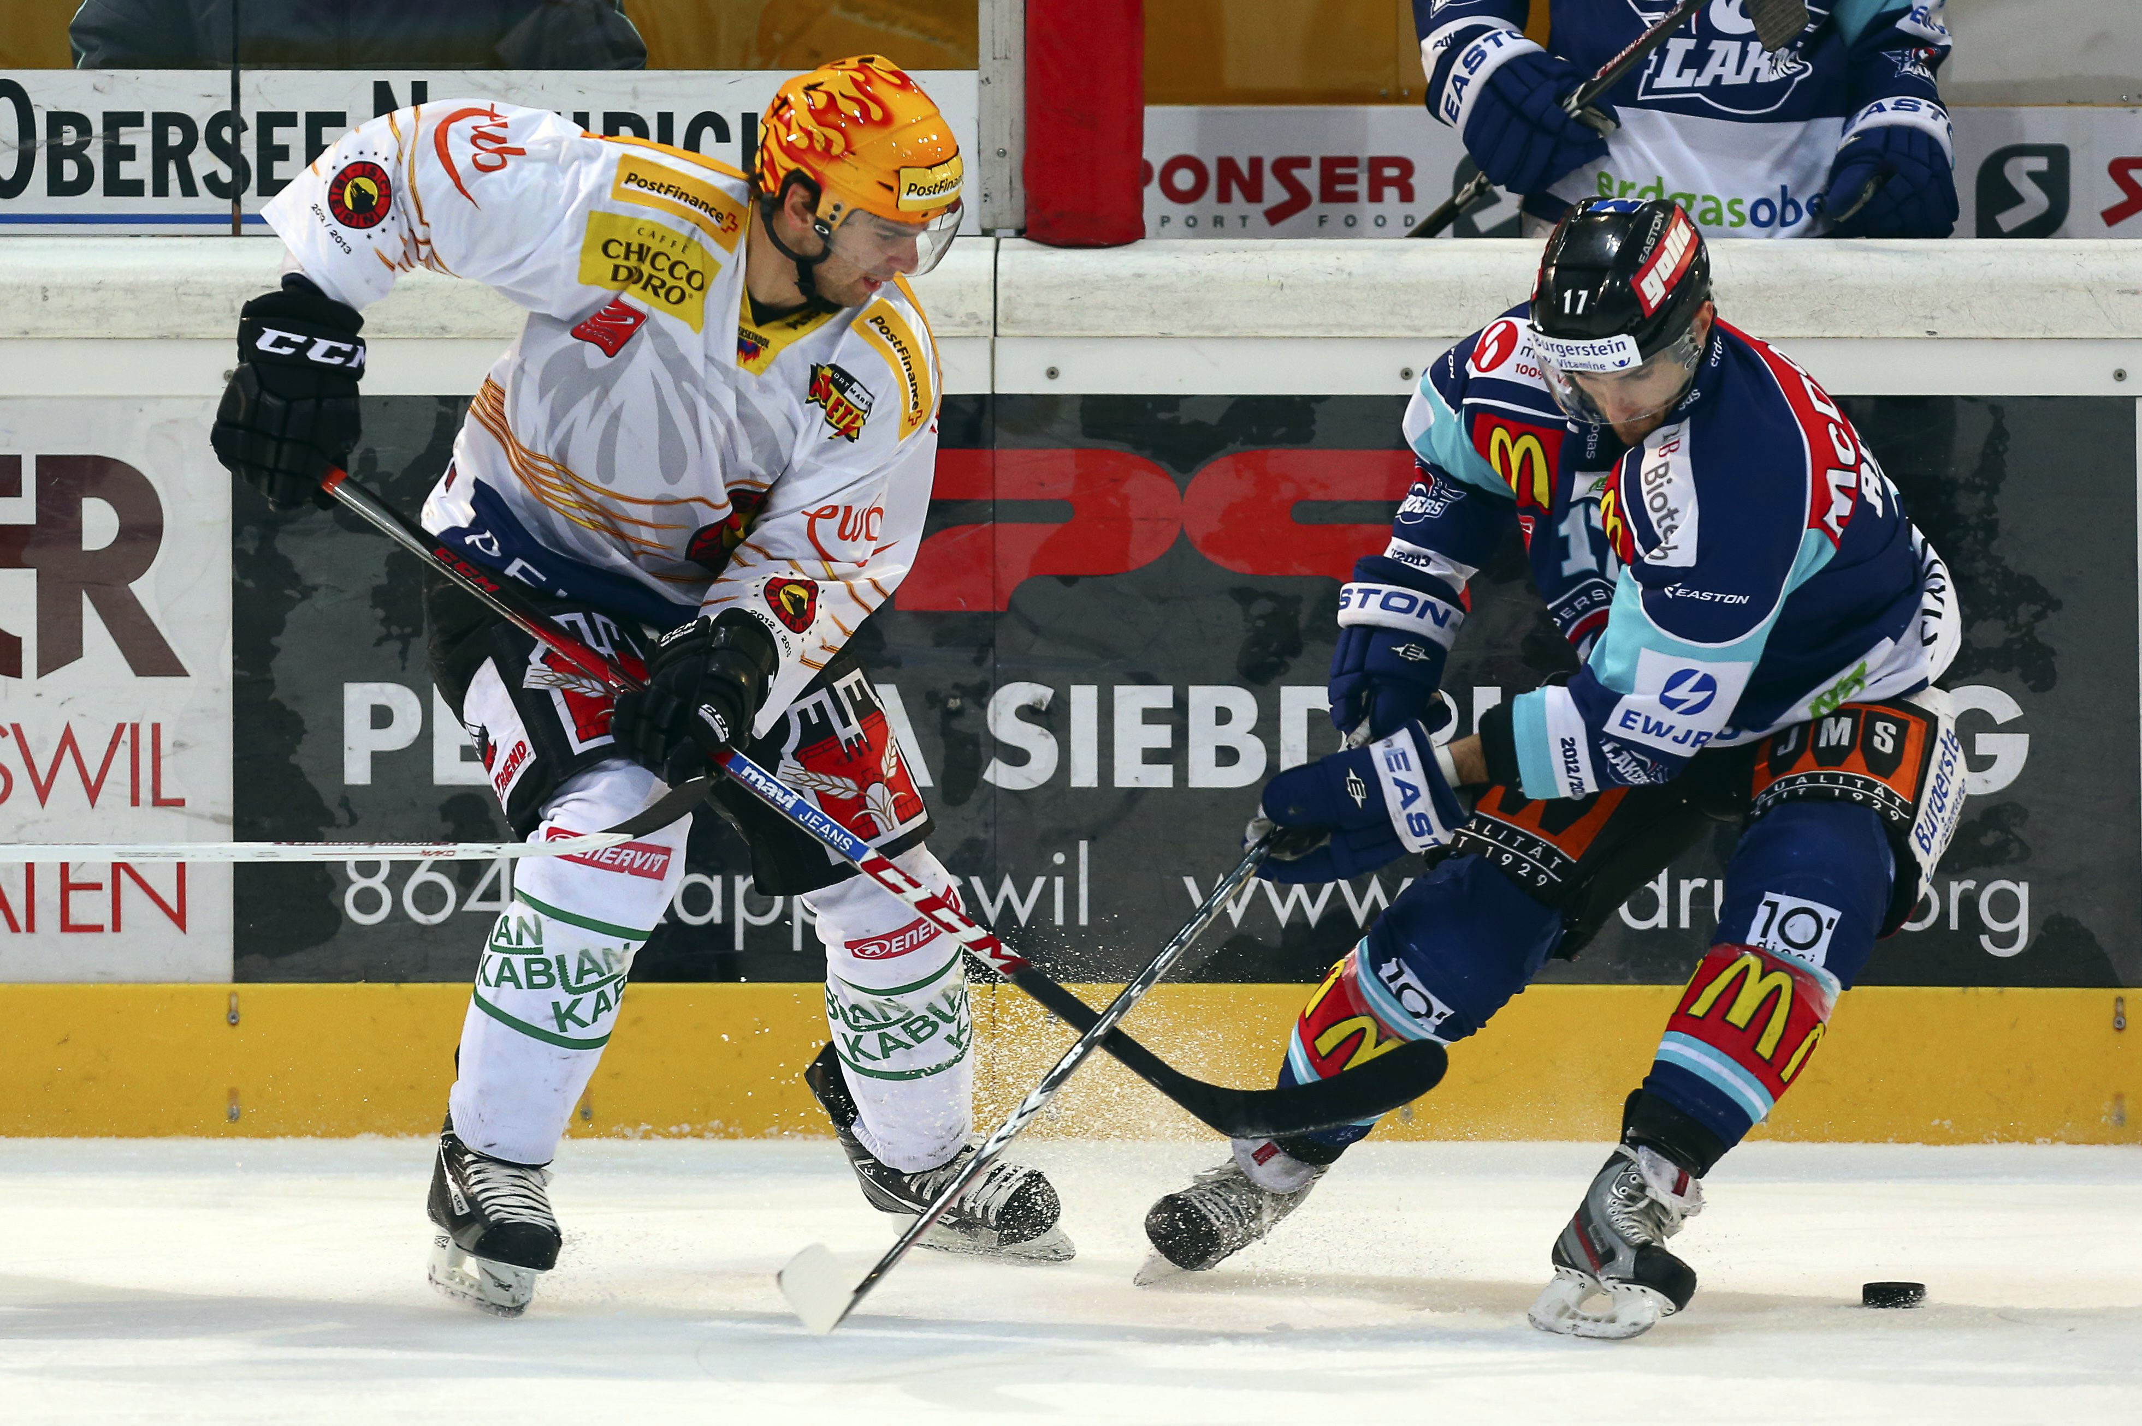
Overview
Predicting next NHL season’s playoff teams based on the NHL’s point system
Software: SAS

Slide 3

Goals
Create a final regression model with the best predictor variables
Predict next season’s individual NHL team points
Create a playoff bracket for the ‘15-’16 season

Slide 4
Predictors
Wins
Losses
Overtime Losses
Regulation Wins
Point Percentage
Goals For Per Game
Goals Against Per Game
Power Play Percentage
Kill Percentage
Shots For Per Game
Shots Against Per Game
Face of Win Percentage

Slide 5
Model Assumptions
Mean of probability distribution of errors is 0
Variance of the errors is constant for all values of the independent variable x (equal variance homoscedastic property, unequal variance heteroscedastic property)
Errors are normally distributed
Errors are independent or uncorrelated

Slide 6
Data Collection
NHL Statistics
http://www.nhl.com/stats/team?reportType=season&report=teamsummary&season=20152016&gameType=2&aggregate=0
Seasons ‘09-’10 to ‘13-’14

Slide 7
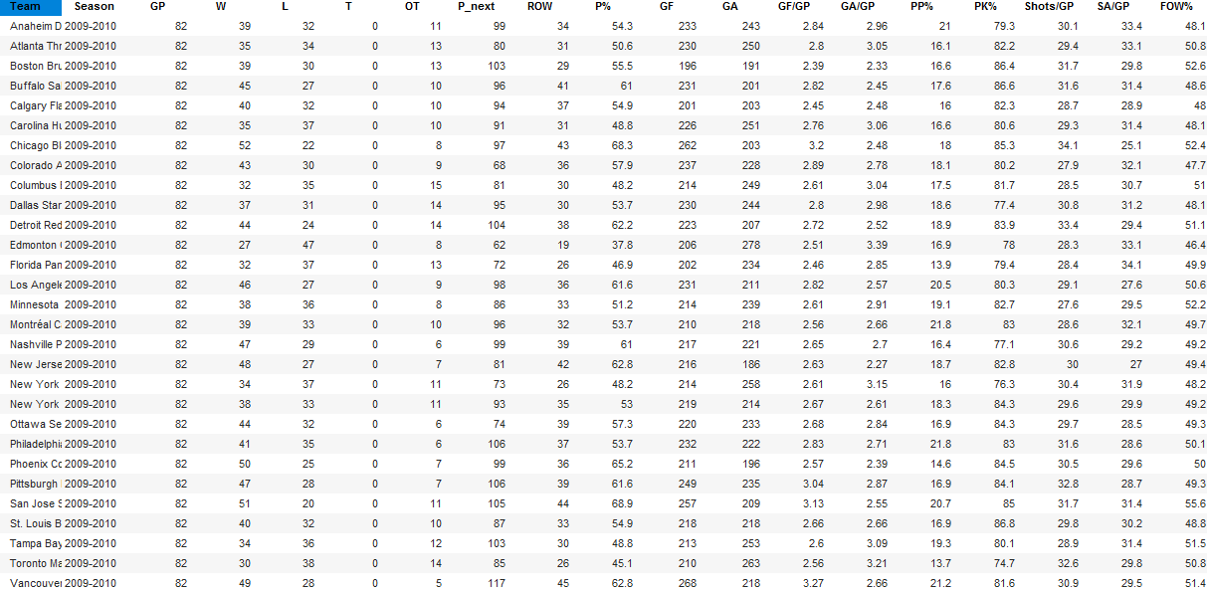
Data Set

Slide 8
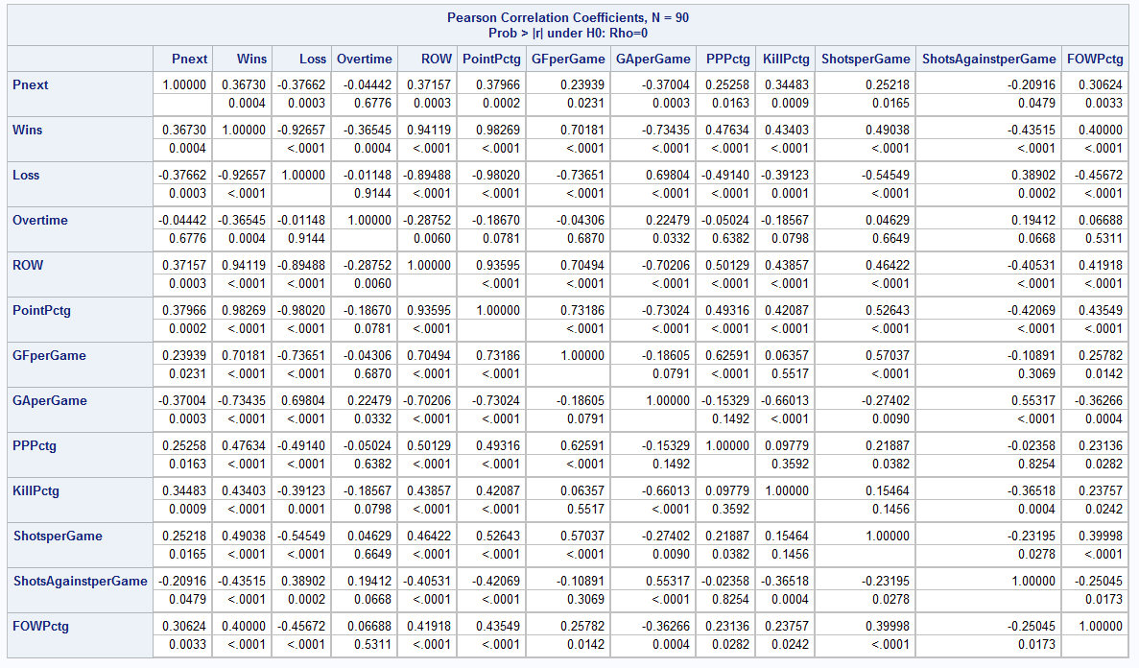
Correlation Matrix
Best Regressors: Losses & Goals for per game
Multicollinearity
Throw out: Wins, ROW & Point percentage

Slide 9
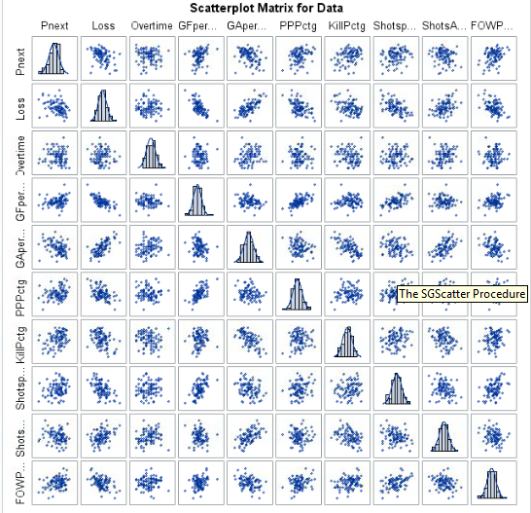
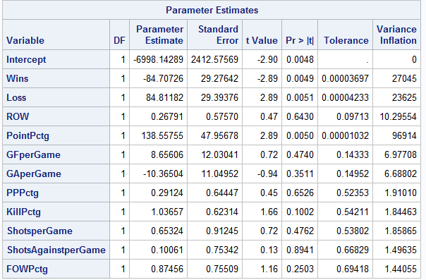
Scatter plot Matrix

Slide 10
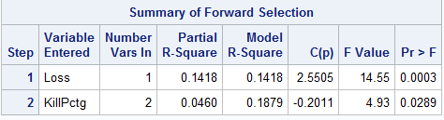
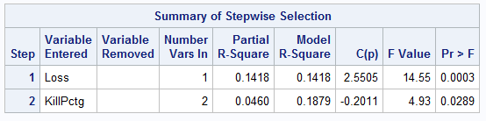
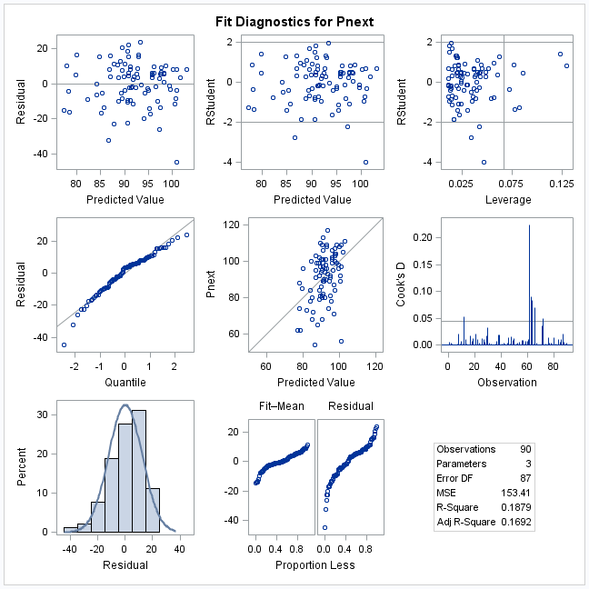
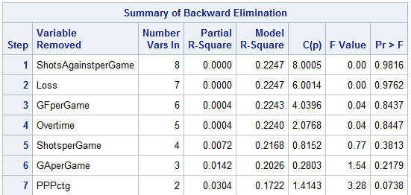
Variable Selection

Slide 11
leverage points, influential points, and outliers
Outliers:
Columbus ‘10-’11
Boston Bruins ‘13-’14
Buffalo Sabres ‘13-’14
No multicollinearity

Slide 12
residual plot vs. fitted values
constant variance of errors

Slide 13
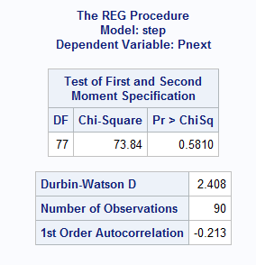
Durbin Watson

Slide 14
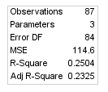
Case with revisions

Slide 15
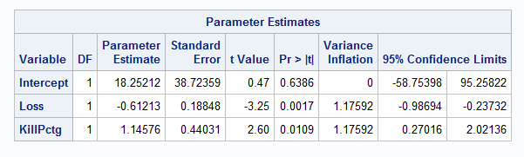
Best model
Model than applied to 14-15 season

Slide 16
Predicted points of 15-16 season
Team | predicted Points
Anaheim Ducks | 96
Arizona Coyotes | 76
Boston Bruins | 96
Buffalo Sabres | 73
Calgary Flame | 92
Carolina Hurricanes | 90
Chicago Blackhawks | 97
Colorado Avalanche | 96
Columbus Blue Jackets | 89
Dallas Stars | 92
Detroit Red Wings | 96
Edmonton Oilers | 79
Florida Panthers | 92
Los Angeles Kings | 94
Minnesota Wild | 100
Montréal Canadiens | 101
Nashville Predators | 96
New Jersey Devils | 89
New York Islanders | 90
New York Rangers | 101
Ottawa Senators | 97
Philadelphia Flyers | 88
Pittsburgh Penguins | 99
San Jose Sharks | 88
St. Louis Blues | 99
Tampa Bay Lightning | 99
Toronto Maple Leafs | 84
Vancouver Canucks | 99
Washington Capitals | 95
Winnipeg Jets | 96

Slide 17
Division bracket
Atlantic |  | Metropolitan |  | Central |  | Pacific
Montreal | 101 | NY Rangers | 101 | Minnesota | 100 | Vancouver | 99
Tampa Bay | 99 | Pittsburgh | 99 | St. Louis | 99 | Anaheim | 96
Ottawa | 97 | Washington | 95 | Chicago | 97 | Los Angeles | 94
Detroit | 96 | NY Islanders | 90 | Nashville | 96 | Calgary | 92
Boston | 96 | Carolina | 90 | Winnipeg | 96 | San Jose | 88
Florida | 94 | New Jersey | 89 | Colorado | 96 | Edmonton | 79
Toronto | 84 | Columbus | 89 | Dallas | 92 | Arizona | 76
Buffalo | 73 | Philidelphia | 88

Slide 18
Limitations
Did not include players, injuries, or trades
More data could have been used
Small R²

Slide 19
Conclusion
Low R² which was .2504
Compared to current standings though it somewhat matches up
Out of the current 16 top teams 13 of them were predicted to make the playoffs

Slide 20
Source
http://www.nhl.com/stats/team?reportType=season&report=teamsummary&season=20152016&gameType=2&aggregate=0

